Slide 1

By :- Kundan Kumar
Business Analyst Career Program - Capstone Project

Slide 2

Agenda
Data Exploration
Statistical Analysis using Excel
Graphical Analysis using Excel
Insert the given data into the SQL server
Import the Data from the SQL Database into PowerBI
Interactive Dashboard by using visualization tools
Conclusion and Inferences
Endnotes

Slide 3
Data Exploration
Initial phase of data analysis
Involves data visualization and statistics
Aims to understand dataset characteristics
Describes size, quantity, and accuracy
Identifies patterns and anomalies
Provides insights into data nature
Steps of Data Exploration and Preparation
Variable Identification.
Univariate Analysis.
Bi-variate Analysis.
Missing values treatment.
Outlier treatment.
Variable transformation.
Variable creation.

Slide 4
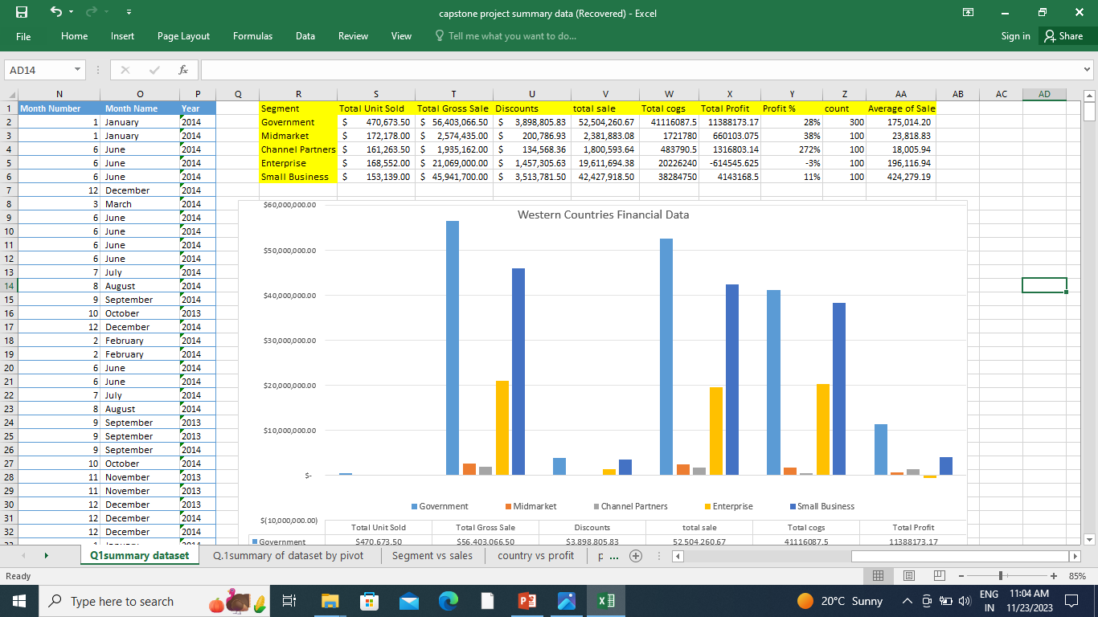

Slide 5
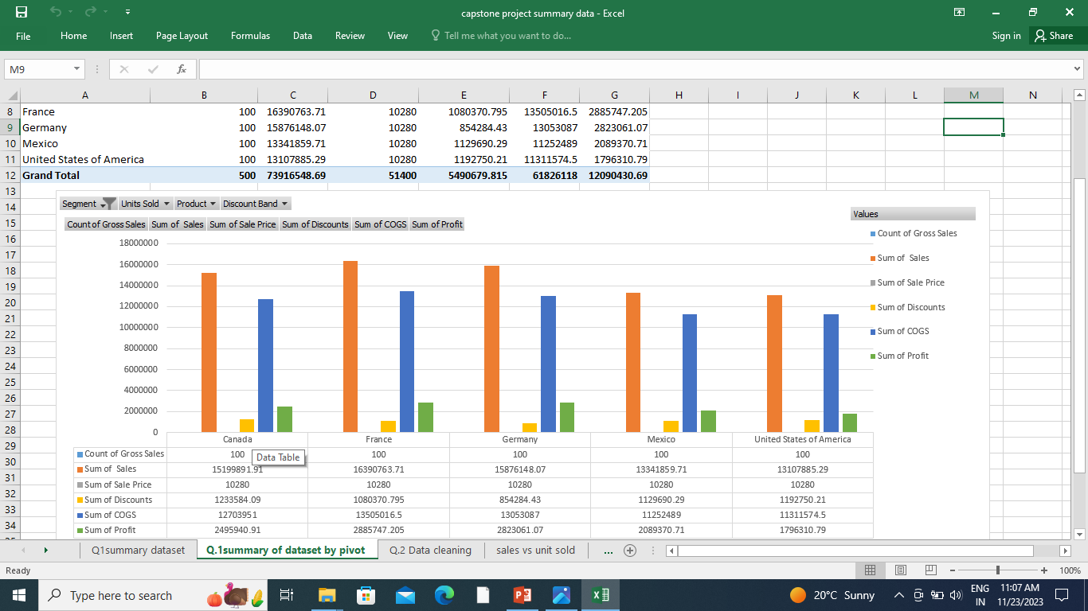

Slide 6
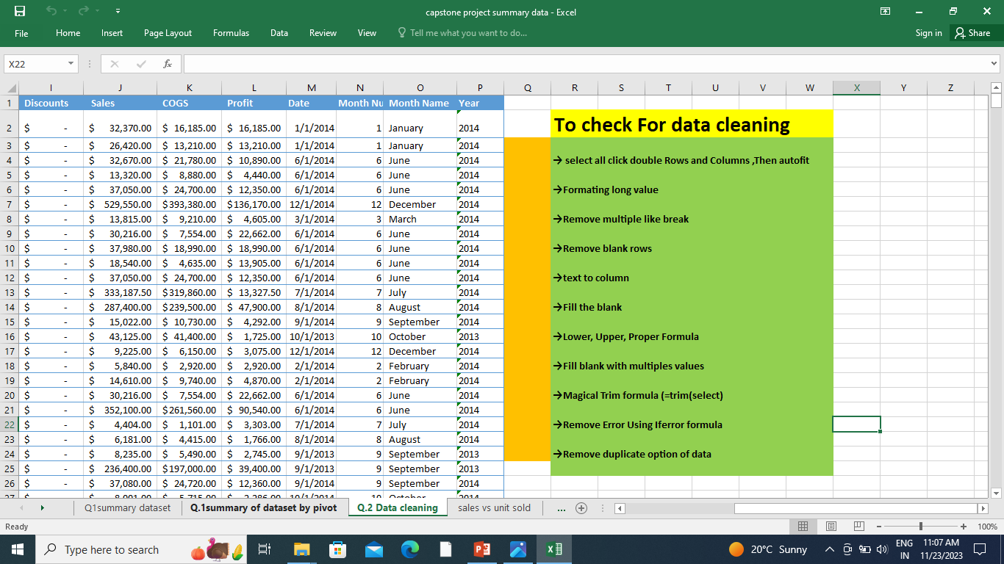
Statistical Analysis using Excel
Data Cleaning :-
Identify and handle missing values
Remove duplicates
Standardize formats (e.g., date formats, text capitalization)
Handle outliers or anomalies appropriately
Validate and correct inaccuracies or inconsistencies
Statistical Analysis :-
Choose appropriate tools (regression, hypothesis testing)
Explore trends, correlations, and significance
Visualize data for insights

Slide 8
Graphical Analysis using Excel
Chart Variety: Excel offers different chart types (bars, lines, pies) for diverse data representation.
Select Data: Choose the data range you want to visualize within Excel.
Label Axes: Clearly label the x and y axes for clarity.
Titles & Legends: Add titles and legends to explain the chart content.
Customization: Customize colors and styles to make the chart visually appealing.
Trends & Highlights: Use trend lines or annotations to emphasize important data trends.
Combine & Compare: Create multiple charts or mix different types for better comparisons.
Interactive Features: Use filters or linked elements to make charts interactive for better exploration.

Slide 9
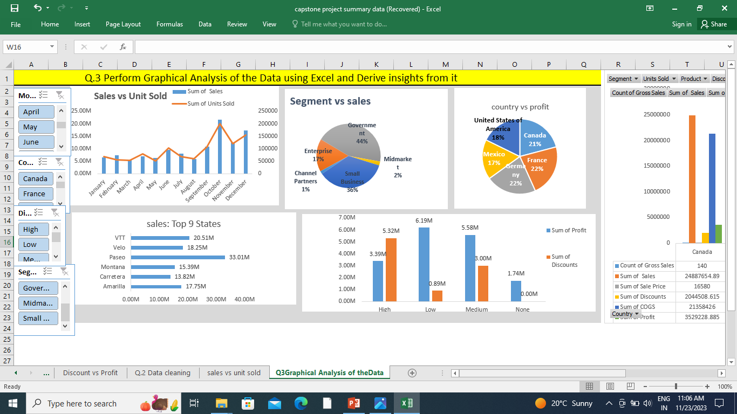

Slide 10
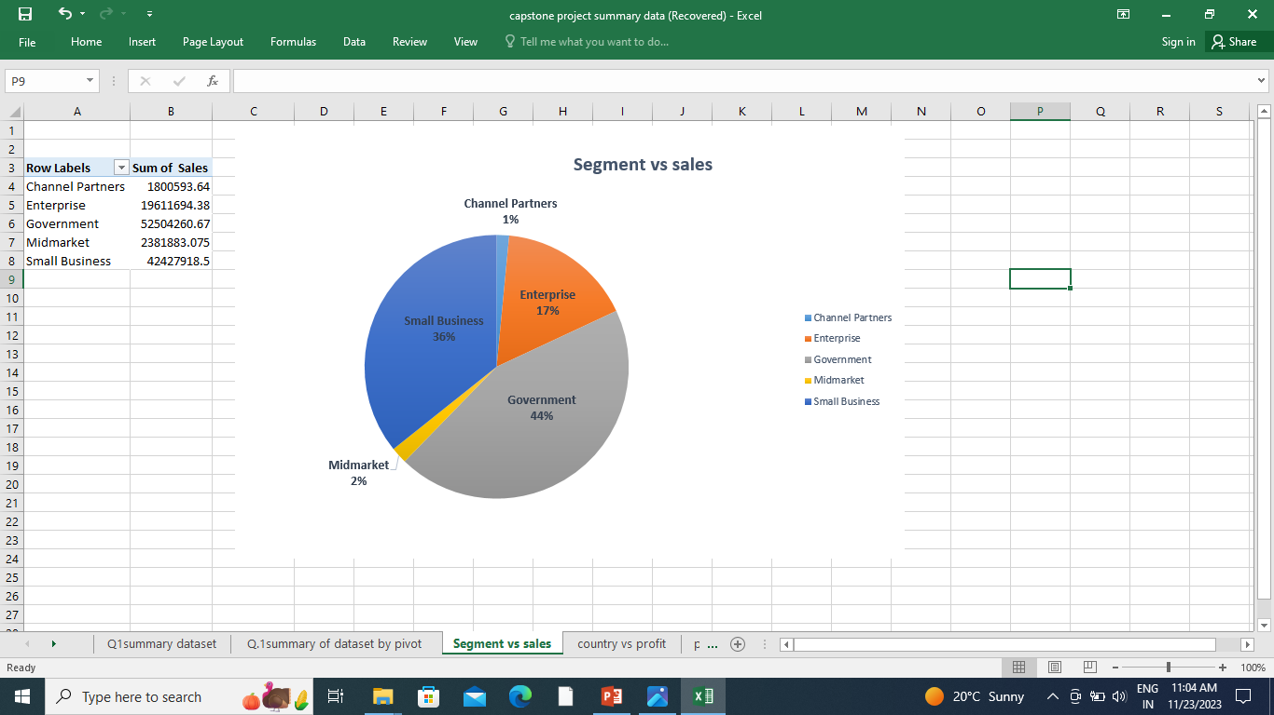

Slide 11
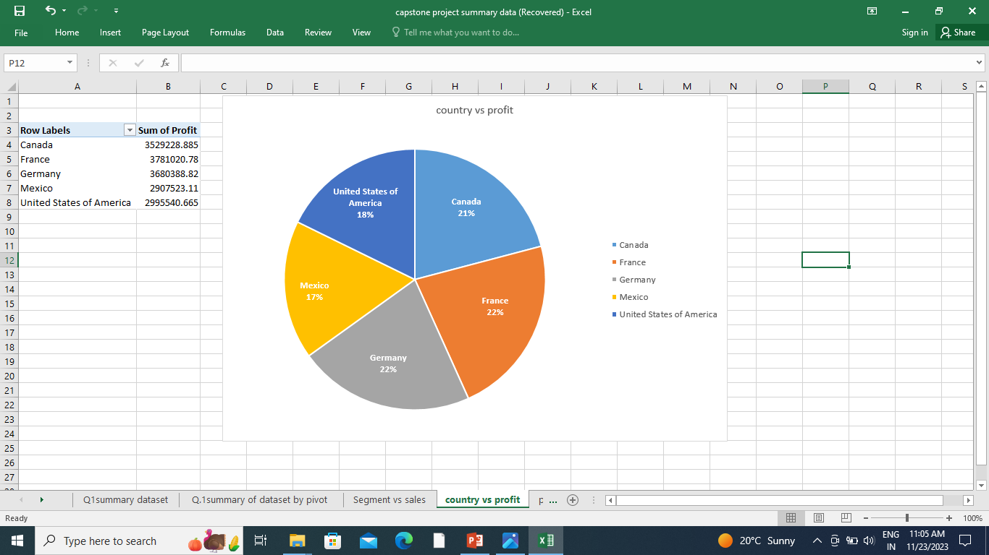

Slide 12
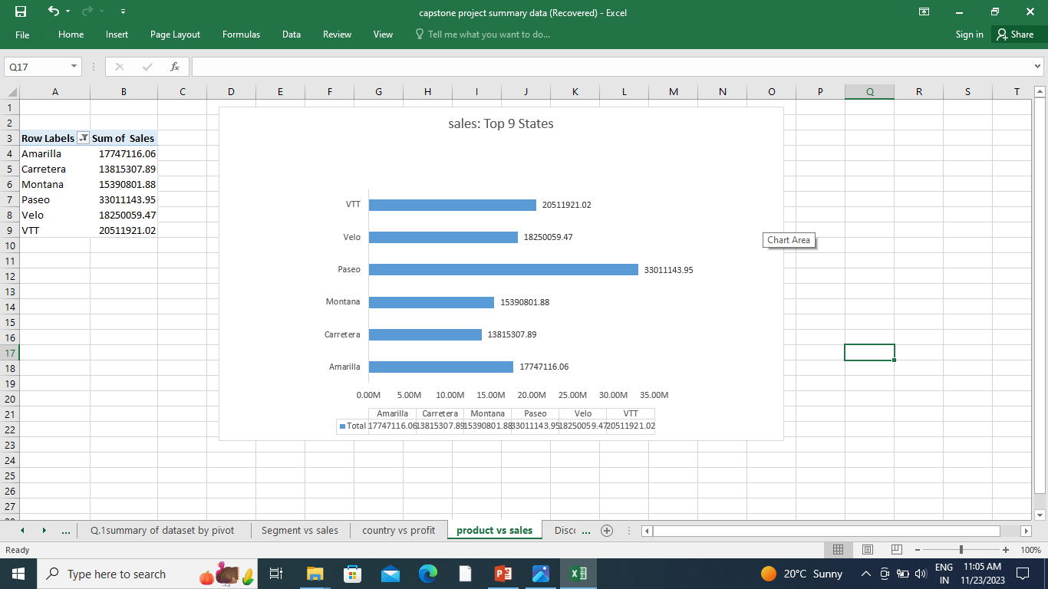

Slide 13
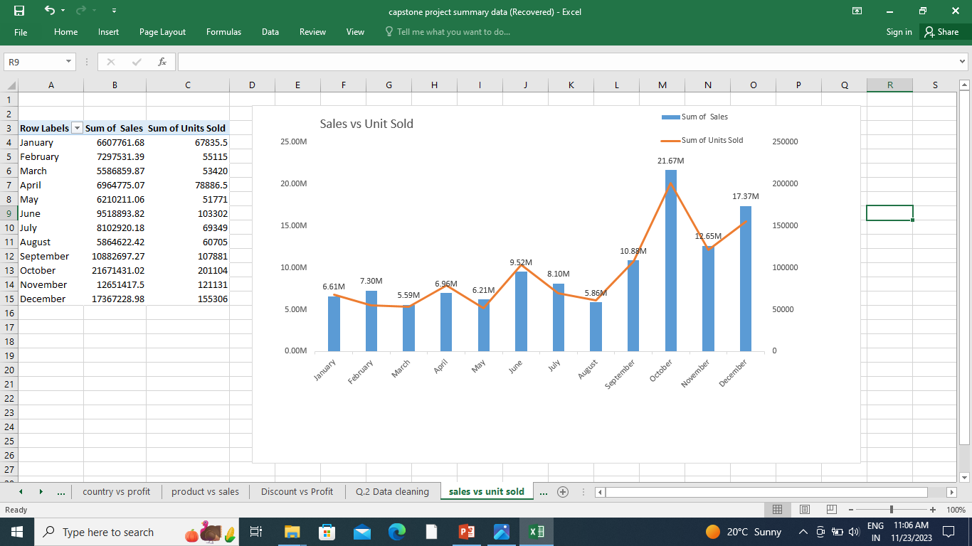

Slide 14
Insert the given data into the SQL server
:
Use INSERT INTO: Start the command with INSERT INTO followed by the table name.
Specify Columns: If not inserting into all columns, specify the columns explicitly.
Provide Values: Use the VALUES keyword followed by the data to be inserted.
Example Syntax:
INSERT INTO Table Name (Column1, Column2, Column3)
VALUES (Value1, Value2, Value3);
For example, assuming a table named Datakk with columns segment, country, and product, etc.
INSERT INTO Datakk(segment, country, Product)
VALUES (Enterprises, France', Montana);

Slide 15
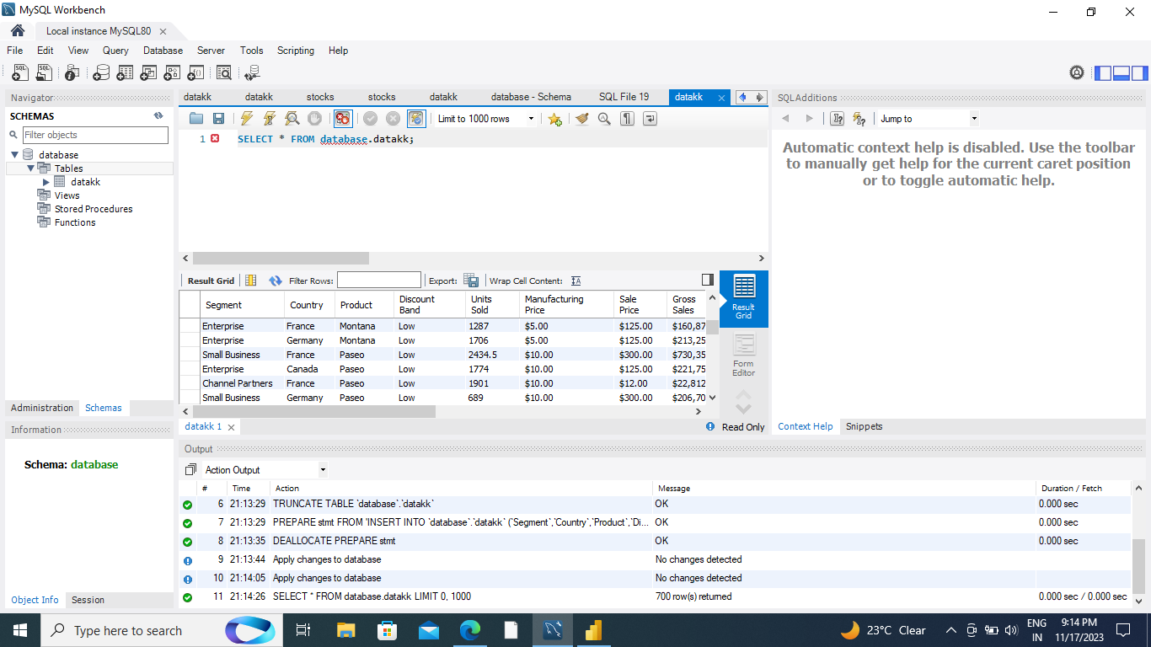

Slide 16
Import the Data from the SQL Database into PowerBI
Open Power BI: Launch the Power BI desktop application.
Get Data: Click on "Get Data" from the Home tab.
Select Database: Choose "SQL Server" from the list of data sources.
Enter Server Details: Input server name and database name.
Choose Data: Select tables or write a SQL query to extract specific data.
Load Data: Click "Load" or "Transform Data" to import and view the data in Power BI.
Data Modeling: Perform any necessary data transformations or modeling within Power BI.
Report Building: Create visualizations or reports based on the imported data.

Slide 17
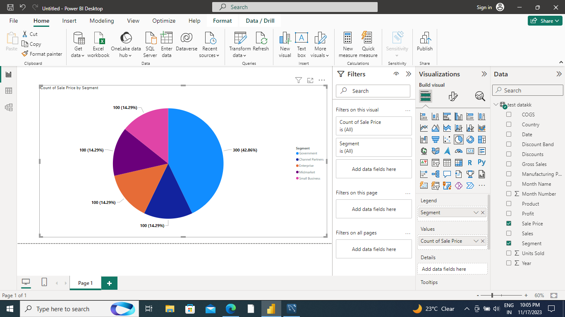

Slide 18
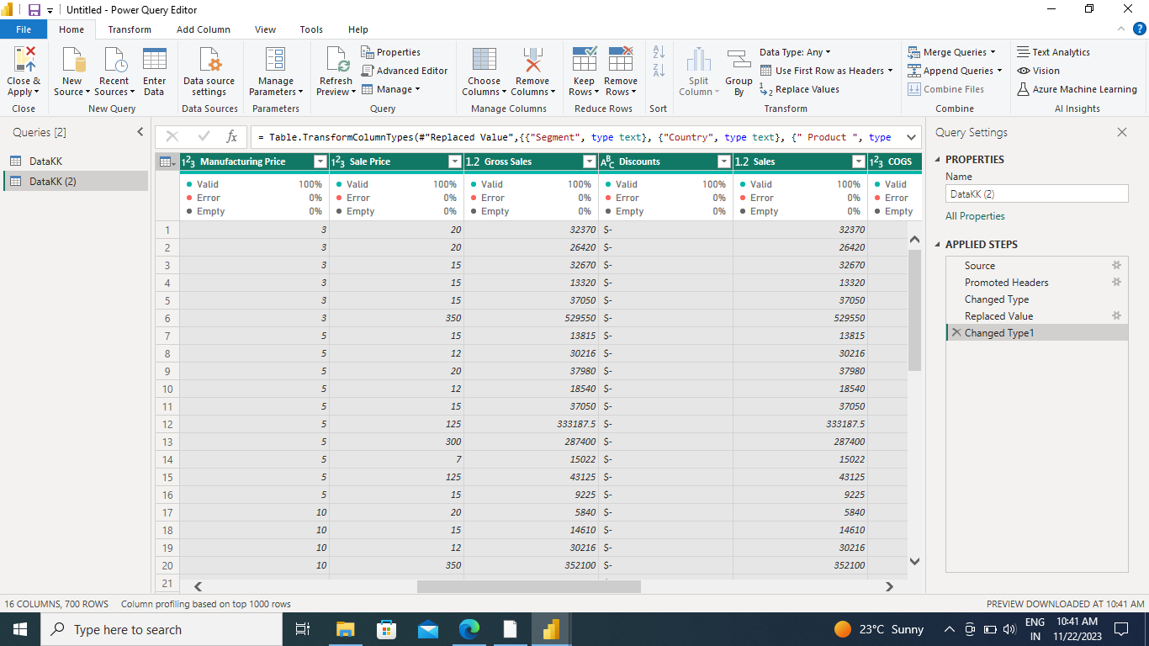

Slide 19
Interactive Dashboard by using visualization tools
Purpose: Define why you're making the dashboard and what you want users to learn from it.
Tool: Choose a visualization tool like Tableau or Power BI.
Data Connection: Import data from different sources into the tool.
Layout: Plan how the dashboard will look - organize data and charts logically.
Visuals: Use graphs and charts that best represent your data.
Interactivity: Add filters or dropdowns to let users explore data.
Test & Refine: Check for usability and accuracy, refine based on feedback.
Share: Publish or share the dashboard with your audience.

Slide 20
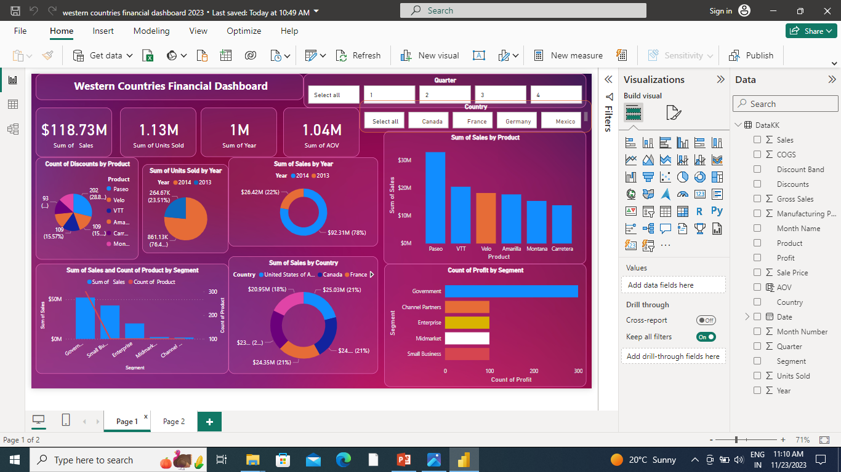

Slide 21
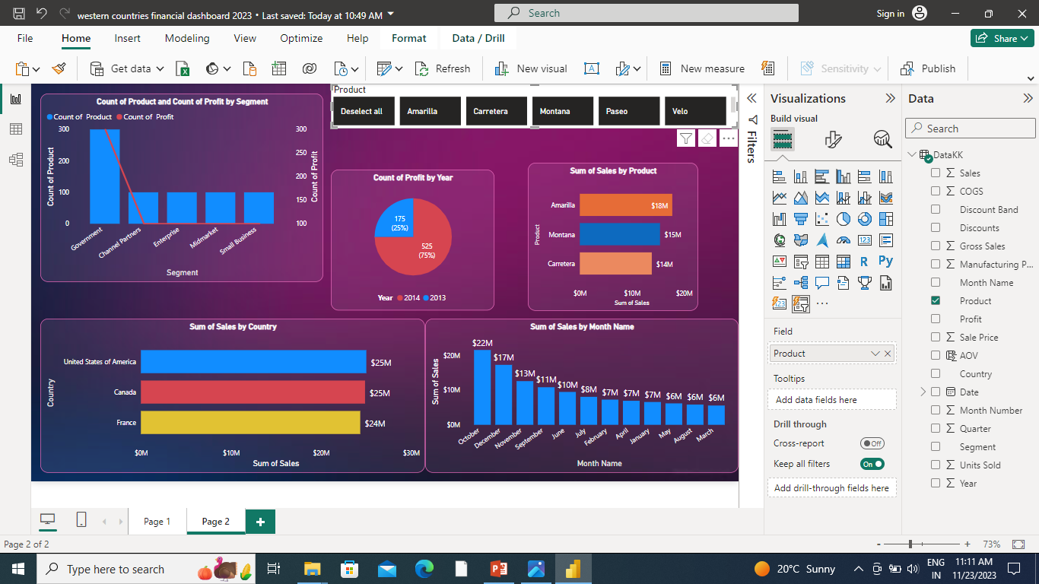

Slide 22
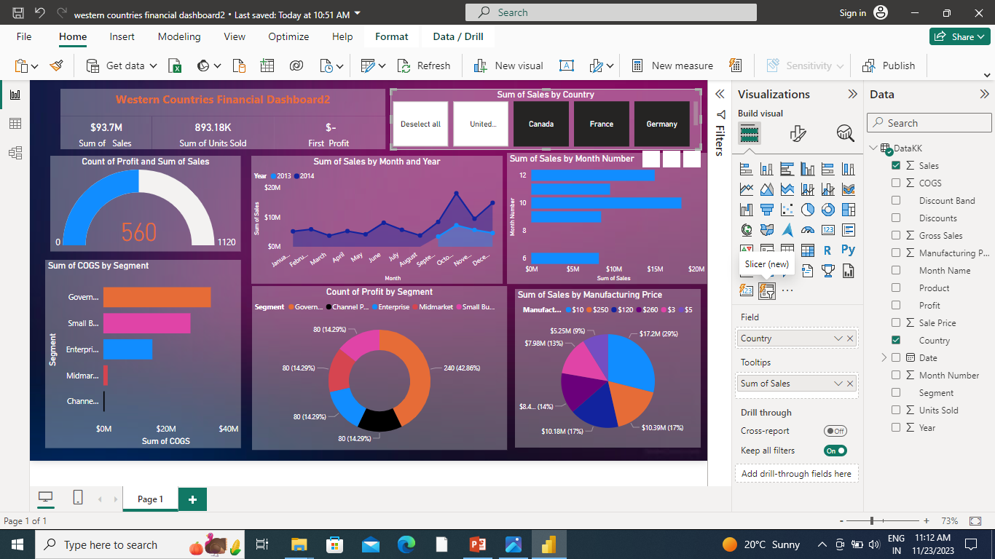

Slide 23
Endnotes
Reference Links:-
Insert related links for Excel file, PowerBI file

Slide 24
Conclusion and Inferences
Graphical analysis using Excel
Excel Analysis: Found important trends and weird things in numbers.
Pretty Pictures: Made colorful graphs to show what the numbers mean.
Big Ideas: Discovered important stuff that helps make decisions.
Visualization tools (Power BI)
Power BI Discovery: Found cool things hiding in numbers.
Pretty Pictures: Made fun pictures to show what the numbers mean.
Smart Choices: Figured out important stuff to make better decisions.

